Slide 1
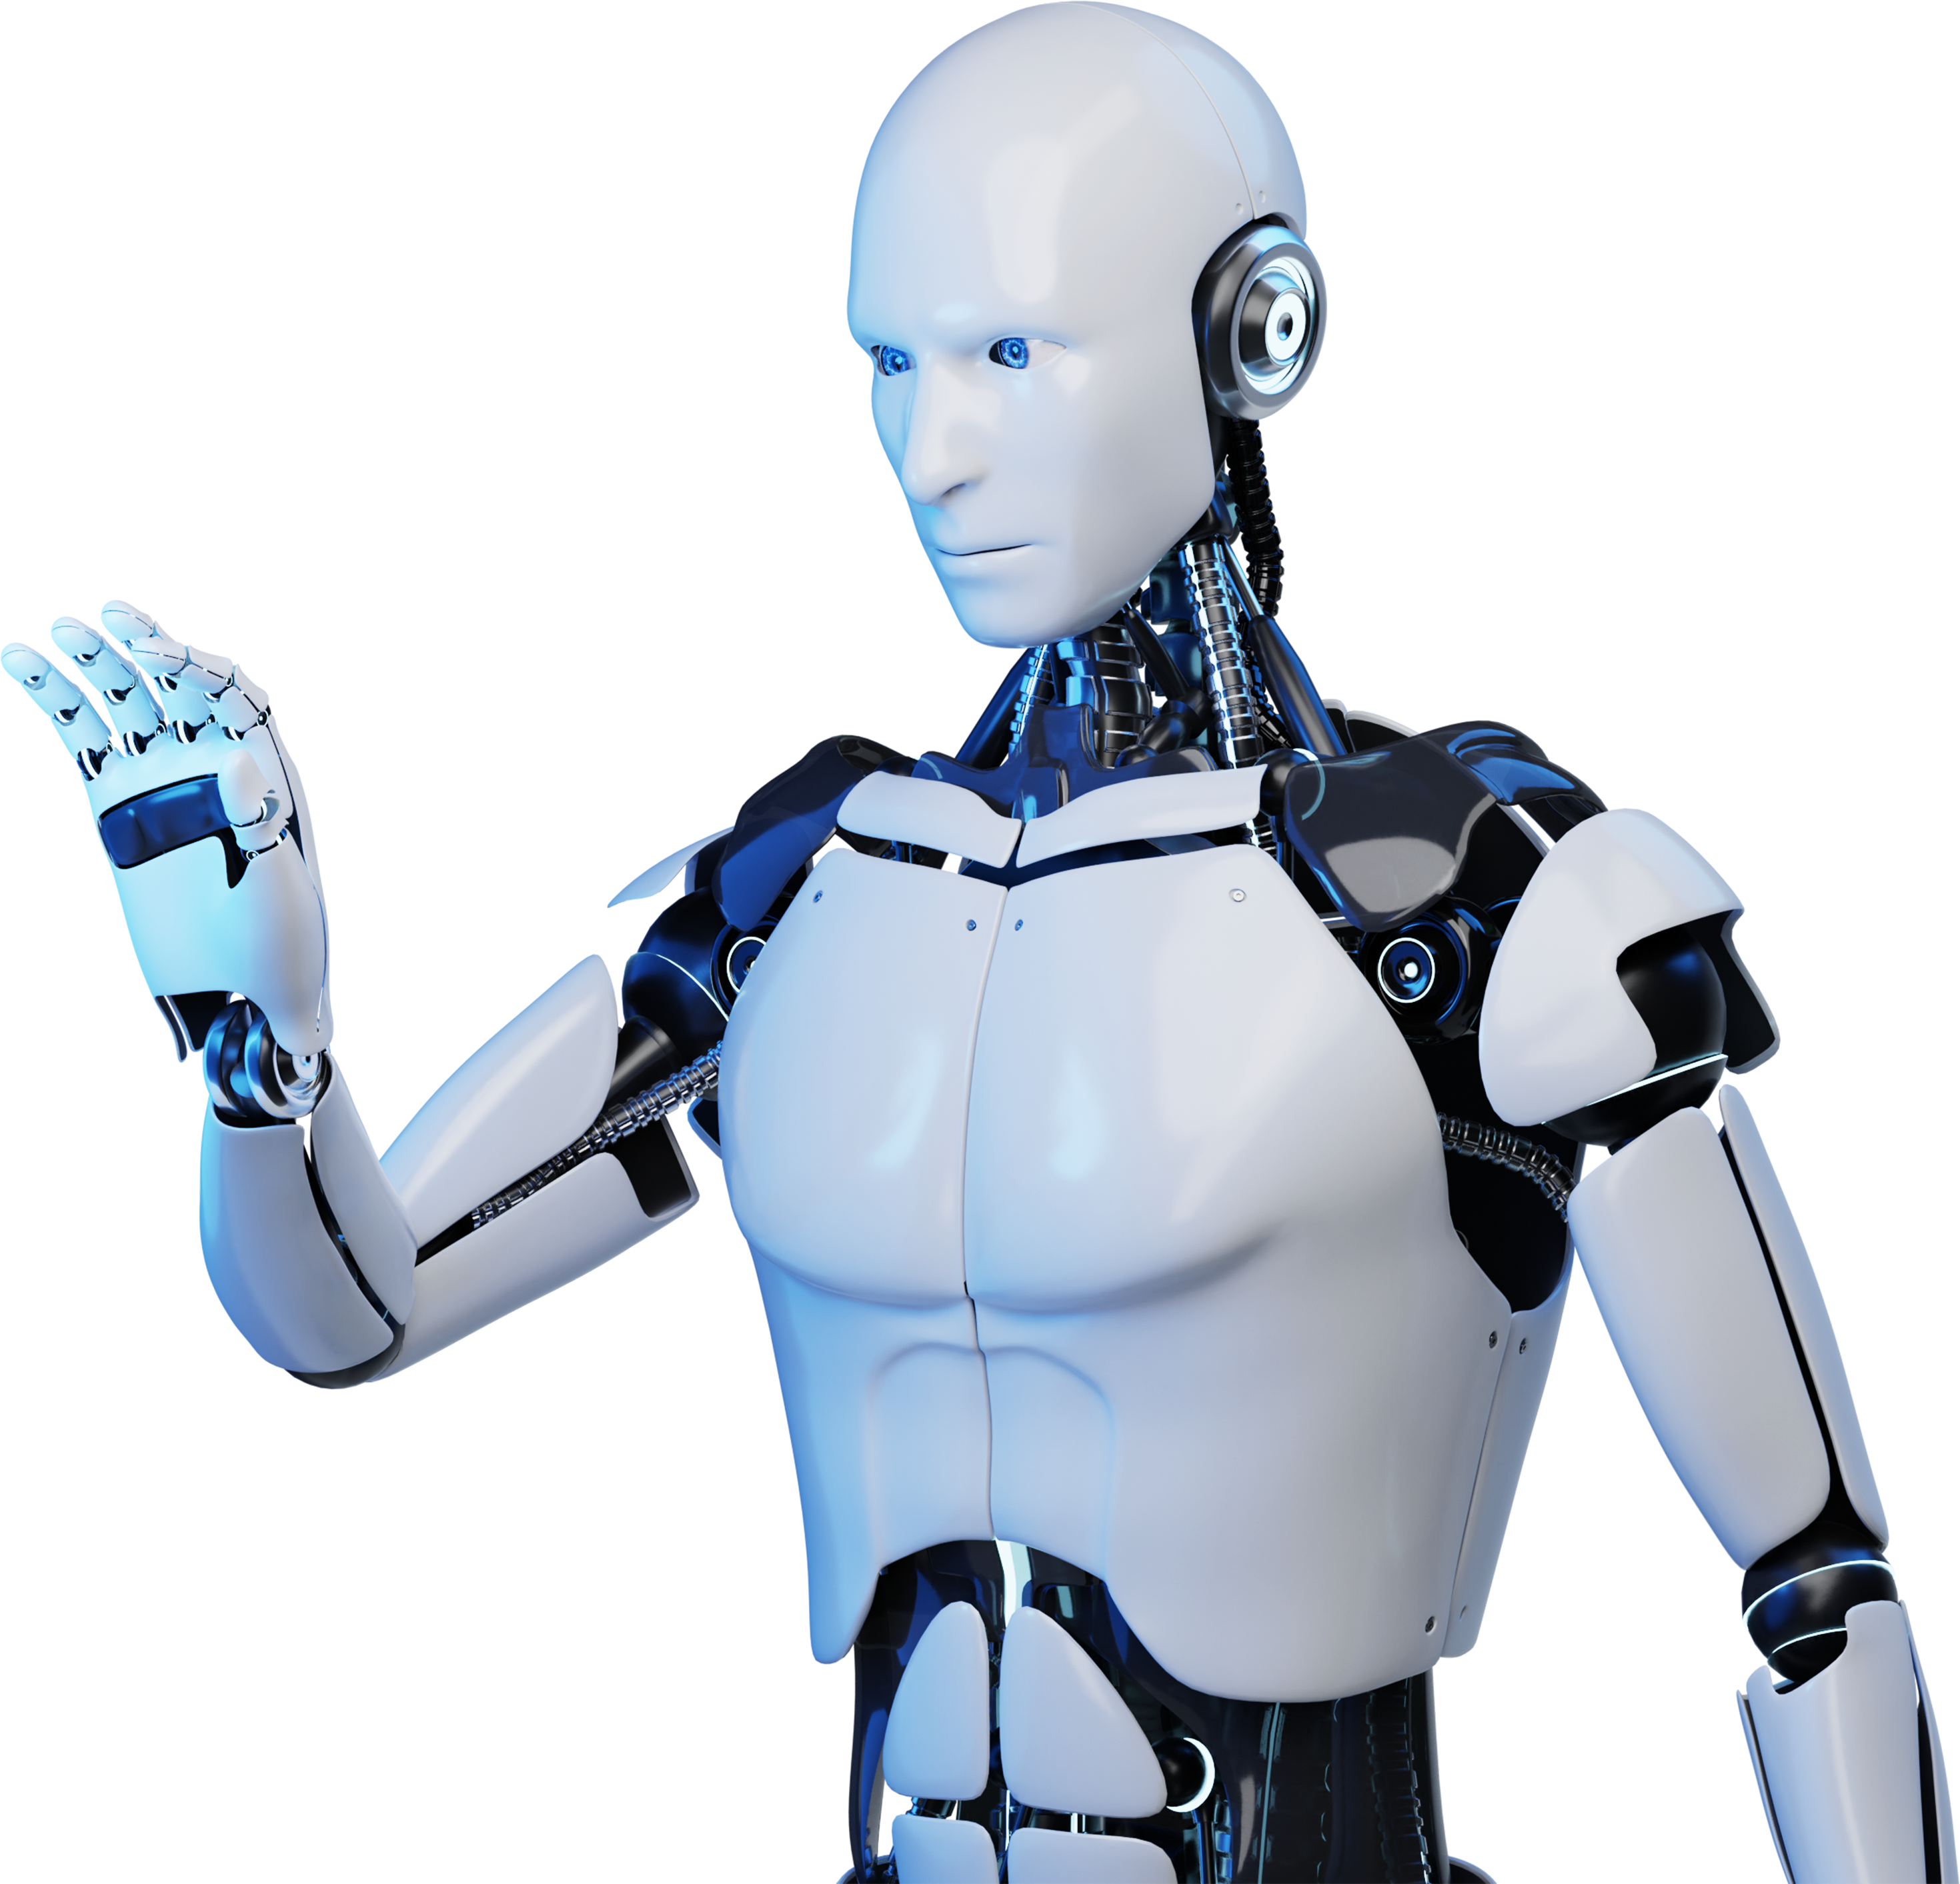
AI Chatbot Presentation

Slide 2
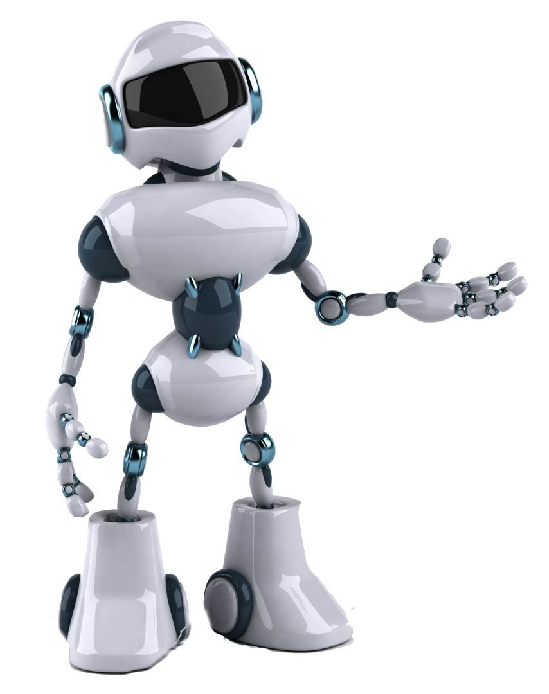
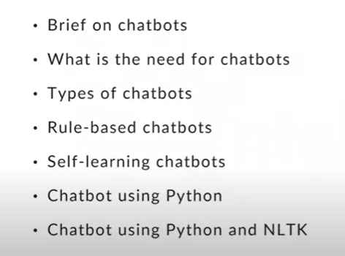
AI Chatbots are computer programs that simulate human conversation, using artificial intelligence to interact with users and provide assistance.
Introduction

Slide 3
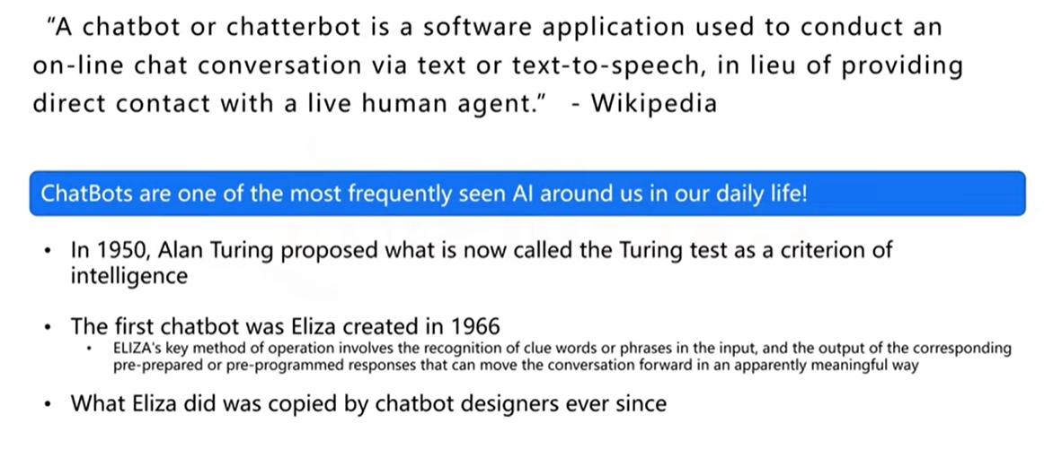
BRIEF ABOUT CHATBOTS

Slide 4
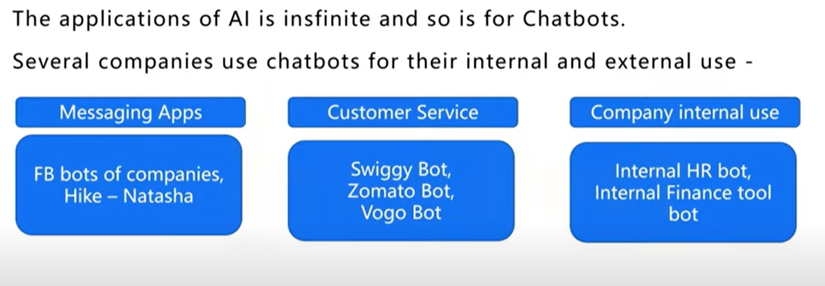
NEED OF CHATBOTS

Slide 5
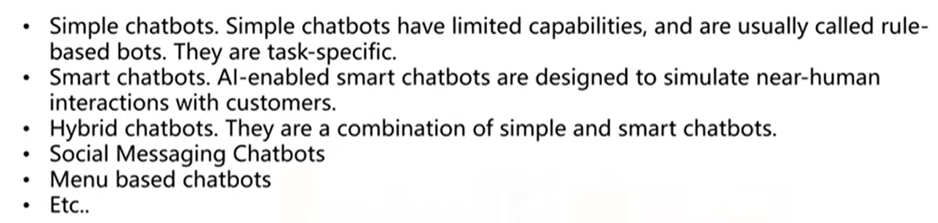
TYPES OF CHATBOTS

Slide 6
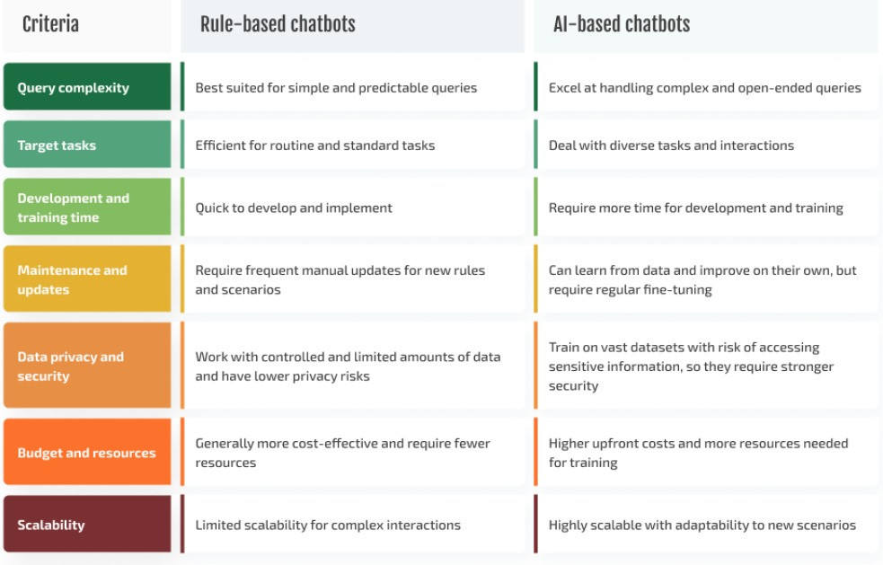
RULE BASED CHATBOTS COMPARISON

Slide 7
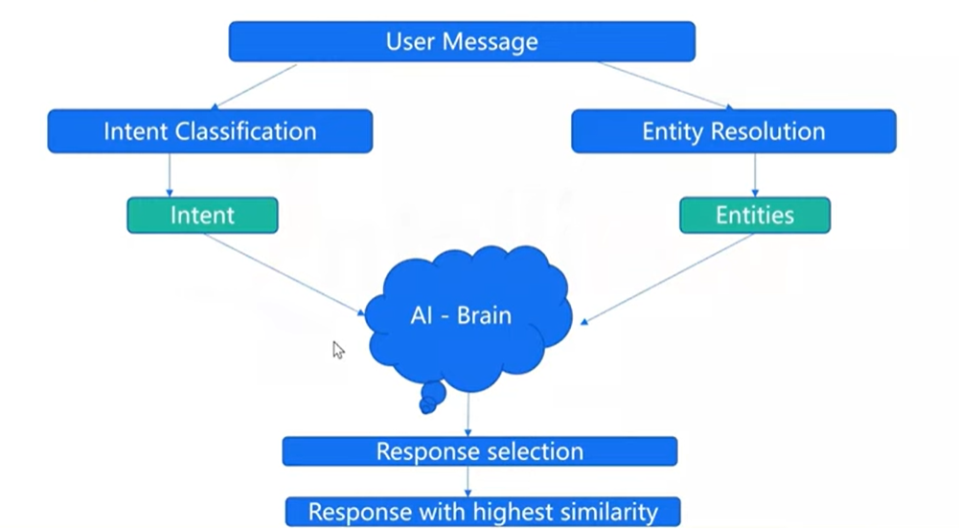
working?
https://colab.research.google.com/drive/1luwXrahJm2My0akFUaWT9_cLG7oERC6H

Slide 8
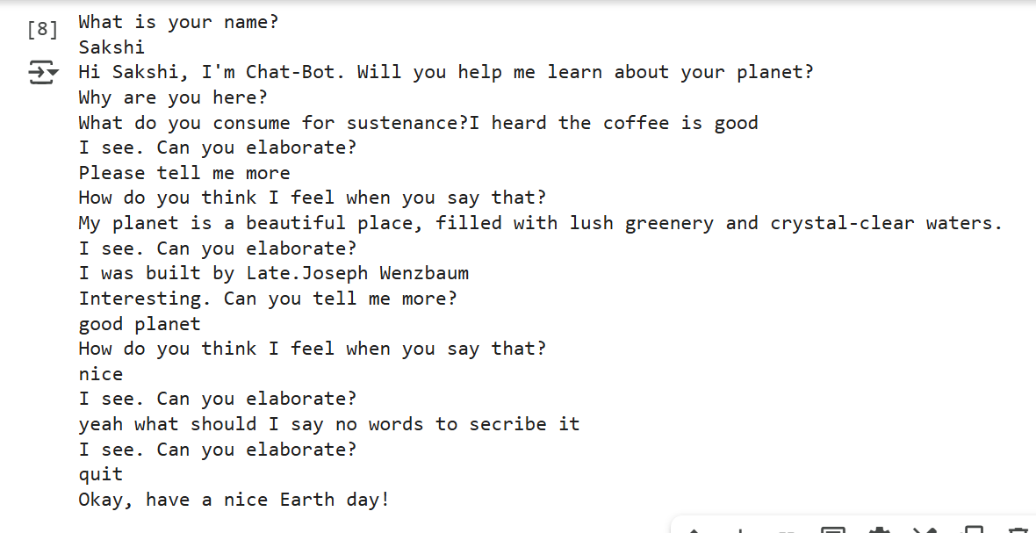
Output of simple bot
Chatbot using Python

Slide 9
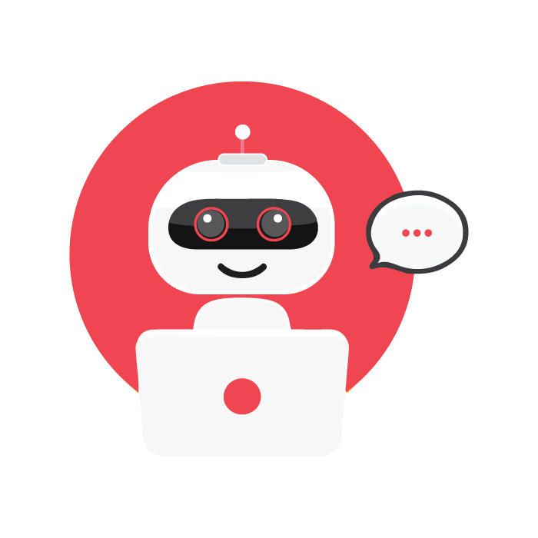
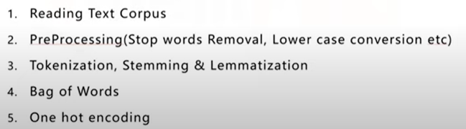
STEPS INVOLVED IN
BUILDING CHATBOT
WITH PYTHON & NLTK

Slide 10
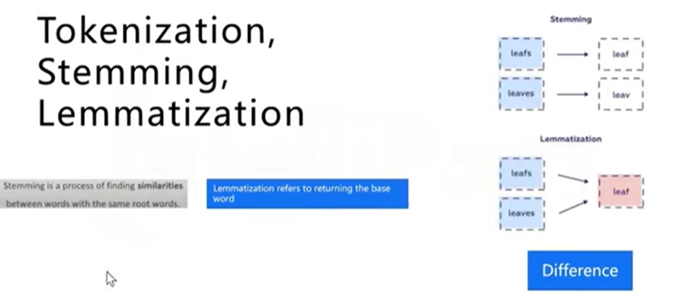

Slide 11
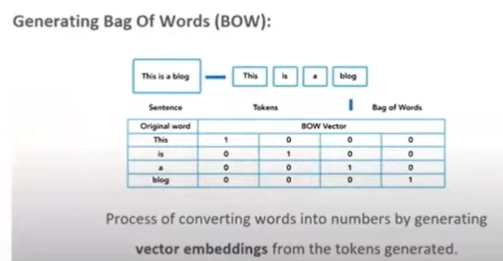
Bag of Words

Slide 12
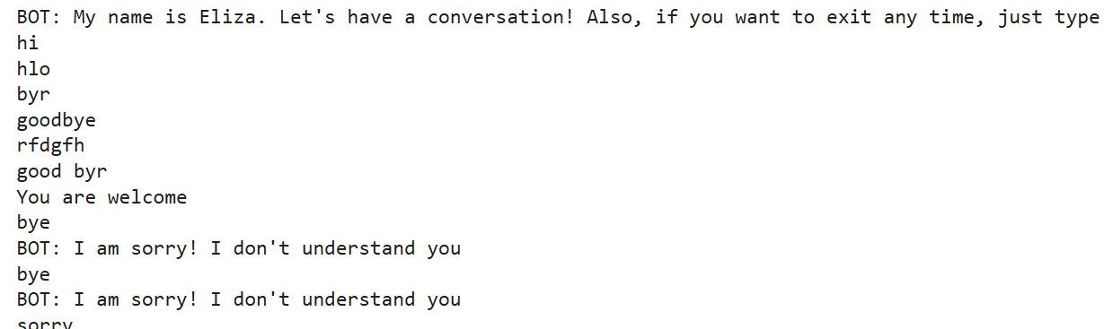
Output of simple bot
Chatbot using Python & NLTK

Slide 13
Advantages In Customer Service
AI Chatbots in customer service offer 24/7 availability, quick response times, personalized interactions, and efficient issue resolution.

Slide 14
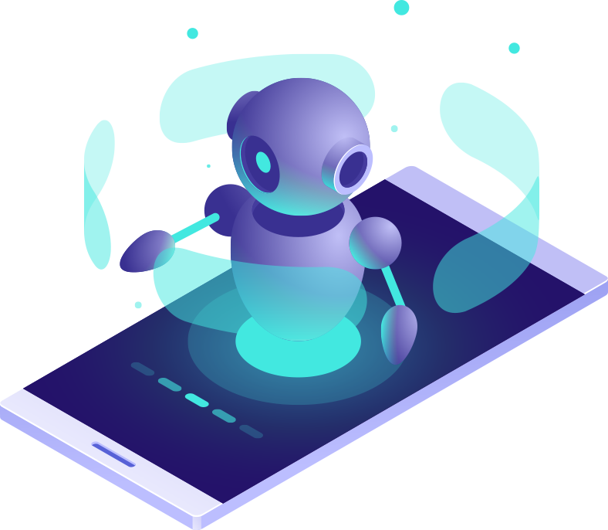
Enhancing
User Experience
By providing seamless and personalized interactions, AI Chatbots enhance user experience, making interactions more efficient and satisfying.

Slide 15
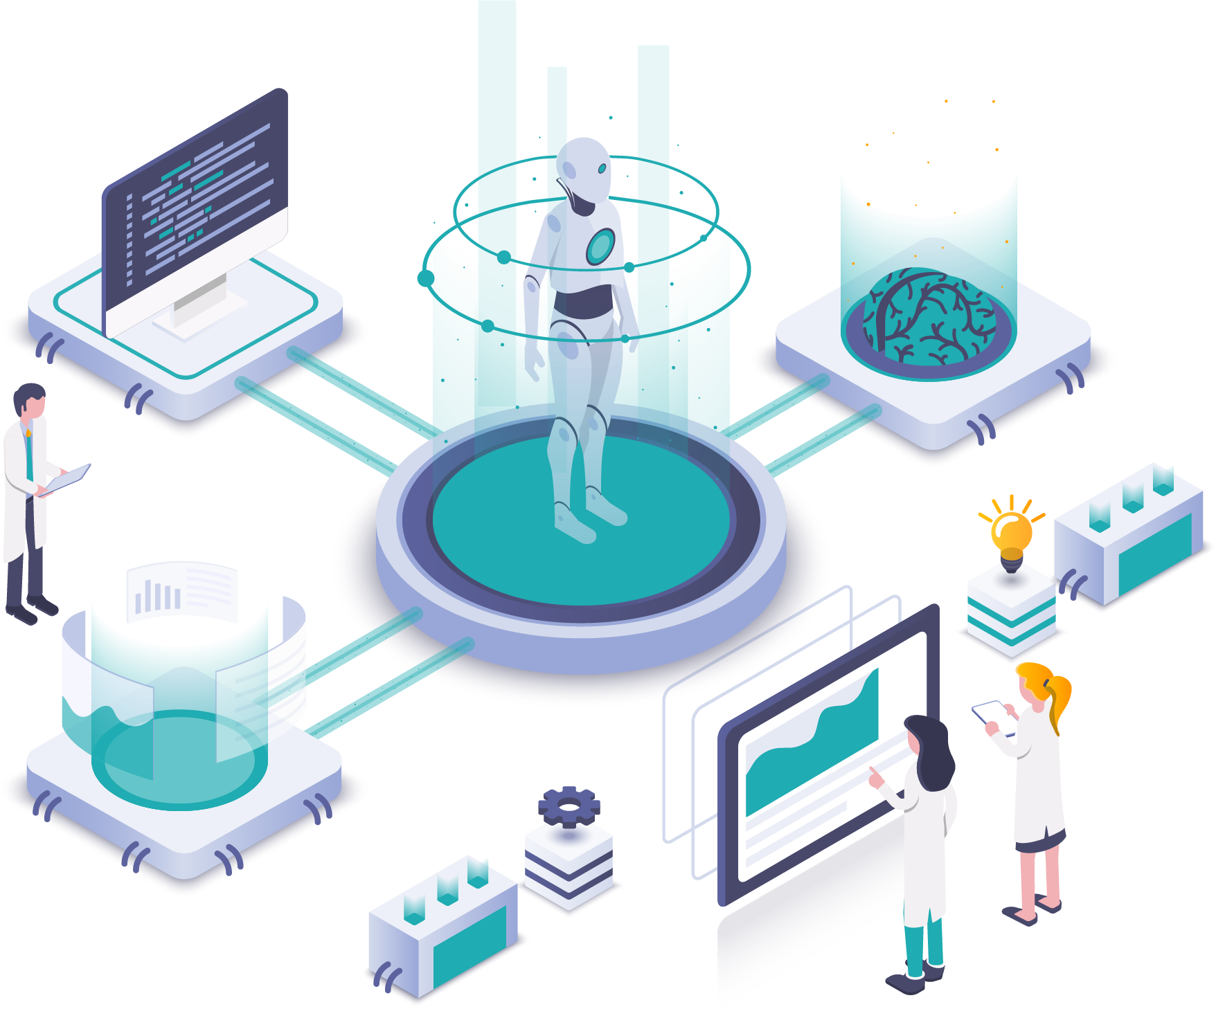
Role Of NLP
Natural Language Processing (NLP) enables AI Chatbots to understand and process human language, allowing for more effective communication.

Slide 16
Design Principles For Interactions
1
User-Centered Design
6
Accessibility and Inclusivity
2
Clarity and Simplicity
7
Learnability
3
Consistency
8
Flexibility and Control
4
Feedback and Responsiveness
9
Error Prevention and Recovery
5
Contextual Relevance
10
Delight and Emotional Engagement

Slide 17

Ethical considerations
Ethical considerations in AI Chatbots include privacy, data security, transparency, bias mitigation, and responsible deployment to ensure user trust.

Slide 18
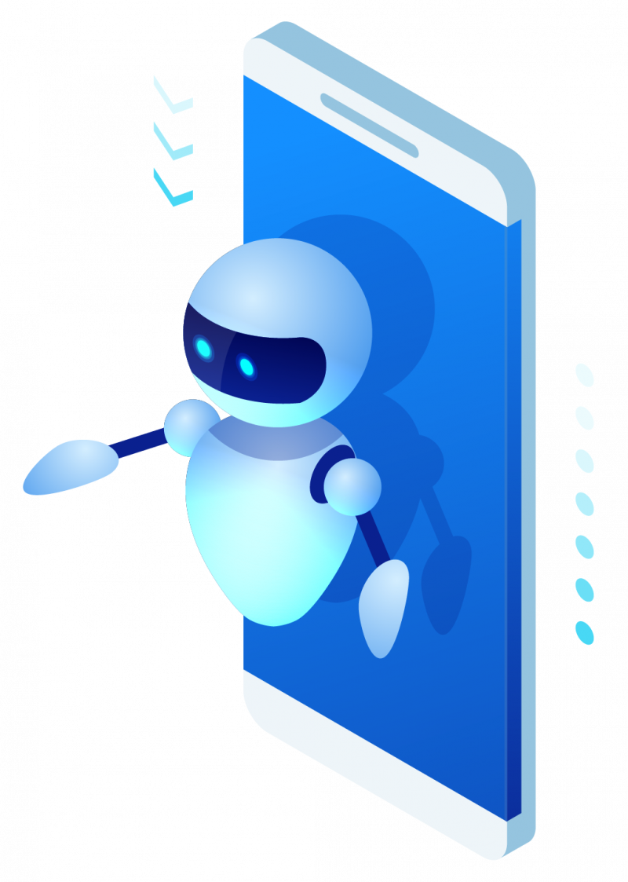
Lead Generation & Conversion
AI Chatbots drive lead generation by engaging prospects, capturing information, and nurturing leads, ultimately increasing conversion rates and sales.

Slide 19
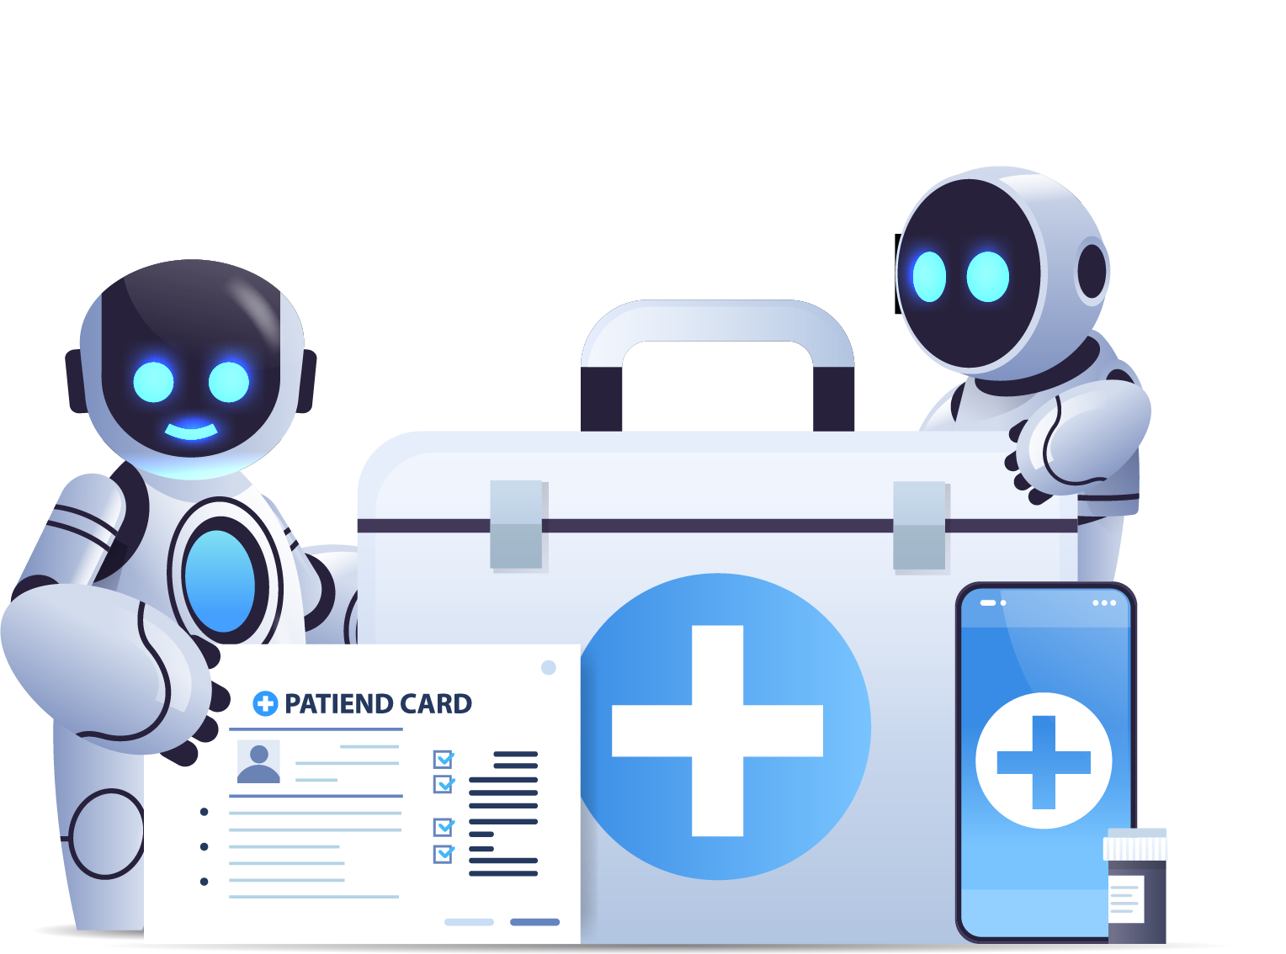
AI Chatbots In Healthcare
Symptom Assessment and Advice
AI Chatbots provide preliminary medical guidance based on symptoms.
Appointment Management
AI Chatbots assist in scheduling and reminding patients of healthcare appointments.
Health Monitoring and Education
AI Chatbots offer personalized health monitoring and educational resources.

Slide 20
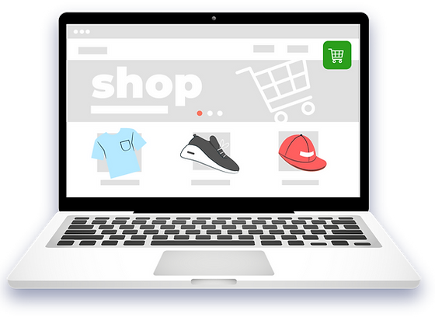
AI Chatbots In E-commerce
AI Chatbots in e-commerce offer personalized product recommendations, assist in purchase decisions, and provide seamless customer support and assistance.

Slide 21
Natural Language Understanding
Lack of Contextual Understanding
Emotional Intelligence
Handling Complex Queries
Lack of Creativity and Empathy
Challenges and limitations
Data Privacy and Security
User Trust and Transparency
Maintenance and Updates

Slide 22
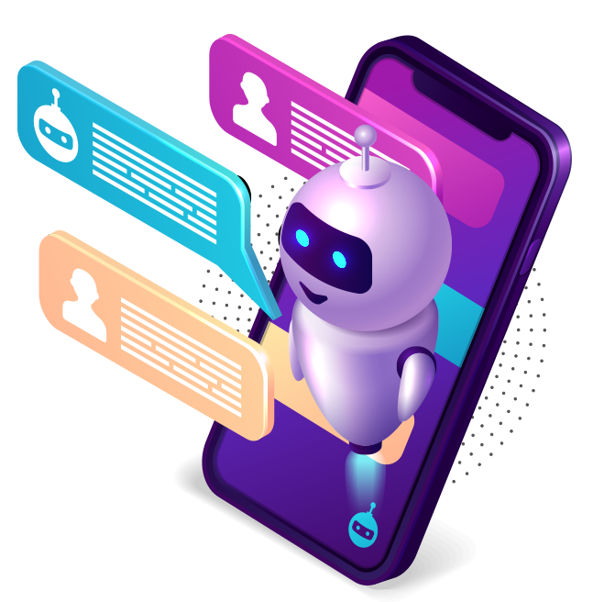
AI Chatbots In Virtual Assistants
AI Chatbots integrated into virtual assistants enhance their capabilities, enabling natural language interactions and seamless task automation.

Slide 23
AI Chatbots
For Knowledge Sharing
Instant Access
AI Chatbots provide immediate access to information, resources, and answers, enhancing knowledge sharing efficiency.
Personalized Assistance
AI Chatbots deliver tailored knowledge support, guiding users through information, learning materials, and relevant resources.

Slide 24
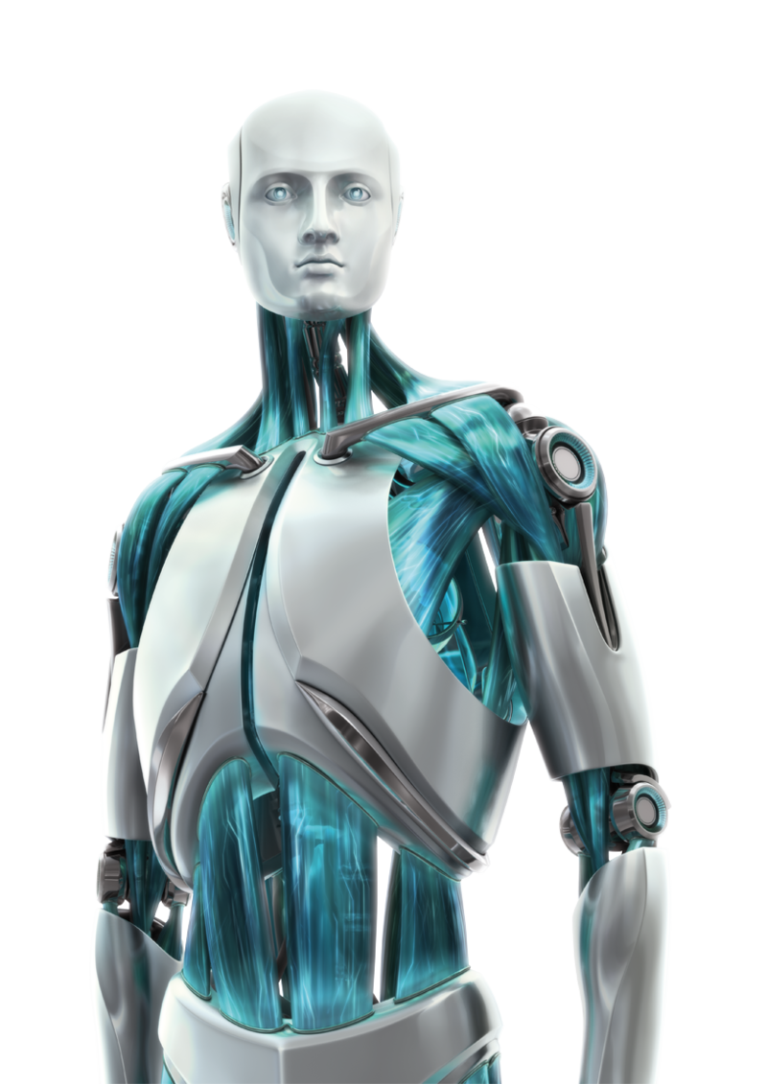
Human-AI Collaboration
Human-AI collaboration combines human expertise with AI Chatbots, enabling more efficient problem-solving, decision-making, and customer interactions.

Slide 25

AI Chatbots In Education
AI Chatbots in education facilitate personalized learning experiences, provide instant feedback, and support student engagement and progress tracking.

Slide 26
AI Chatbots For Social Media
AI chatbots have become increasingly popular for social media platforms as they offer businesses and users a range of benefits. Here are some ways AI chatbots are used on social media:
Customer Support
Interactive Content Delivery
Personalized Recommendations
Automated Posting and Scheduling
Lead Generation and Qualification
Influencer Marketing
Social Listening and Sentiment Analysis
Social Media Advertising

Slide 27
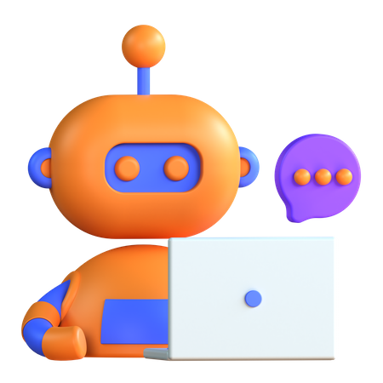
Future Trends In Technology
Future trends in technology include advancements in AI Chatbot capabilities, such as improved natural language understanding and contextual conversations.

Slide 28
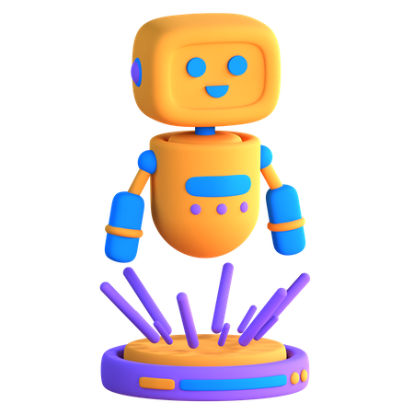
Conclusion
In conclusion, AI Chatbots revolutionize customer service, enhance user experiences, and drive operational efficiency, empowering businesses to thrive.

Slide 29
"AI is like a canvas, and human creativity is the paint brush that brings it to life."

